Slide 1

Growth Session 1
Making a Kotlin Cheat Sheet for JavaScript developers while developing and Android app
By Maxim, Arnaud and Tim

Slide 2

Motivation
We wanted to discover Android development
Kotlin is the new standard for Android development
Compare Kotlin to Java
Not too difficult for non-dev

Slide 3



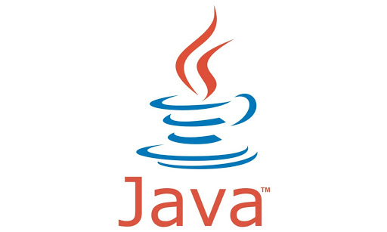
What is Kotlin
A programming language akin to java (but better)
Compile the same way as java (and needs the JVM)
Can also compile to JavaScript or native code
Created by JetBrains (who also makes IDEs like WebStorm or IntelliJ)
Performance is the same as Java

Slide 4
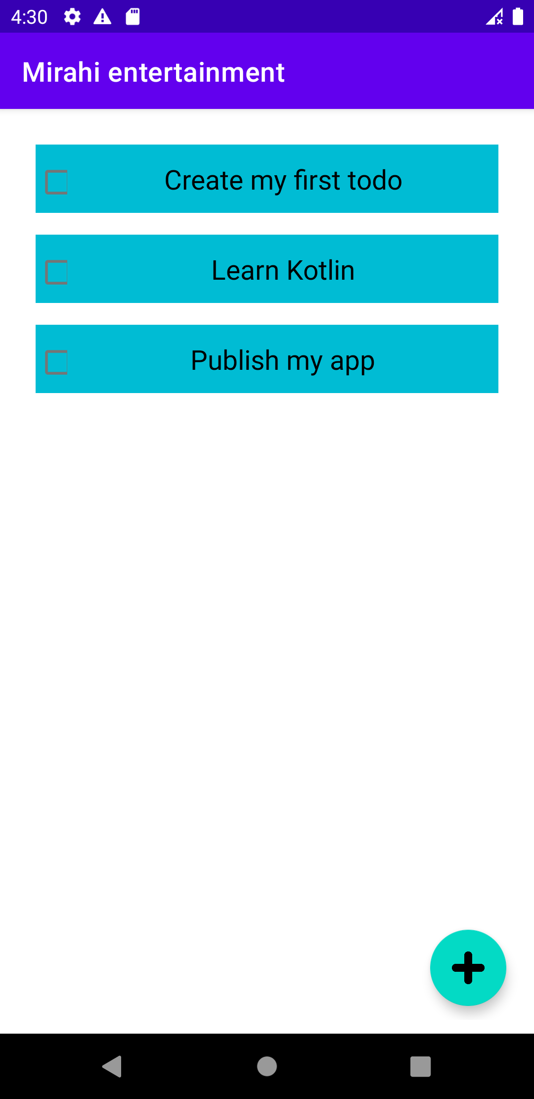
The project
We made a simple Todo app because
Easy to finish in one day
Doesn't require a design
Even if we don't finish all the features we have something to show

Slide 5
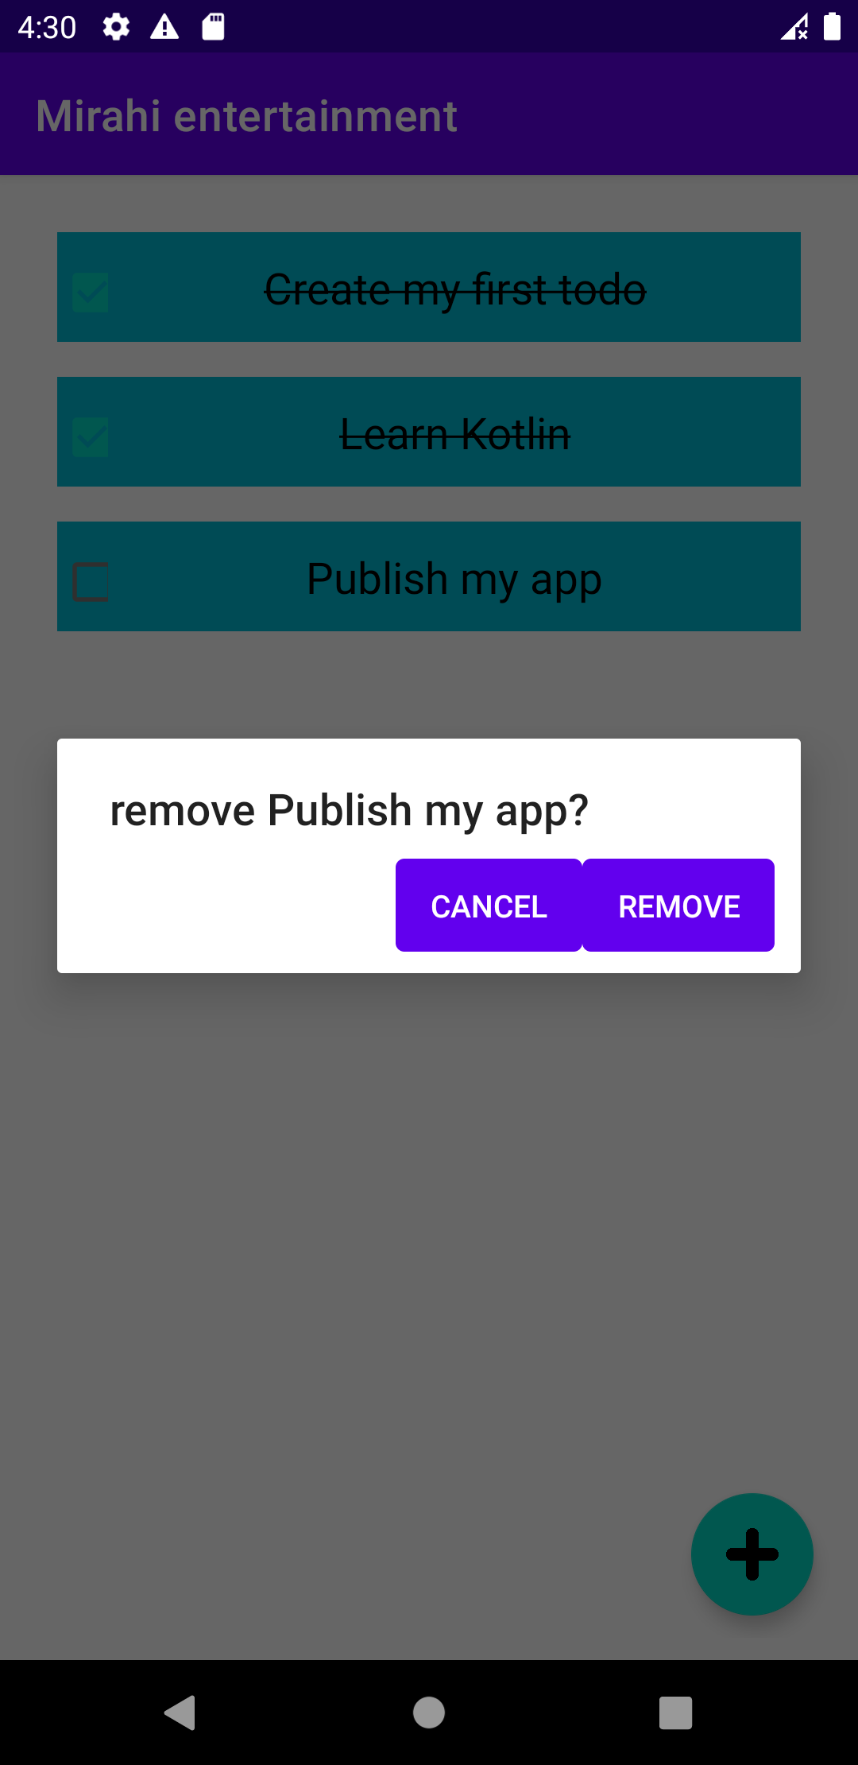
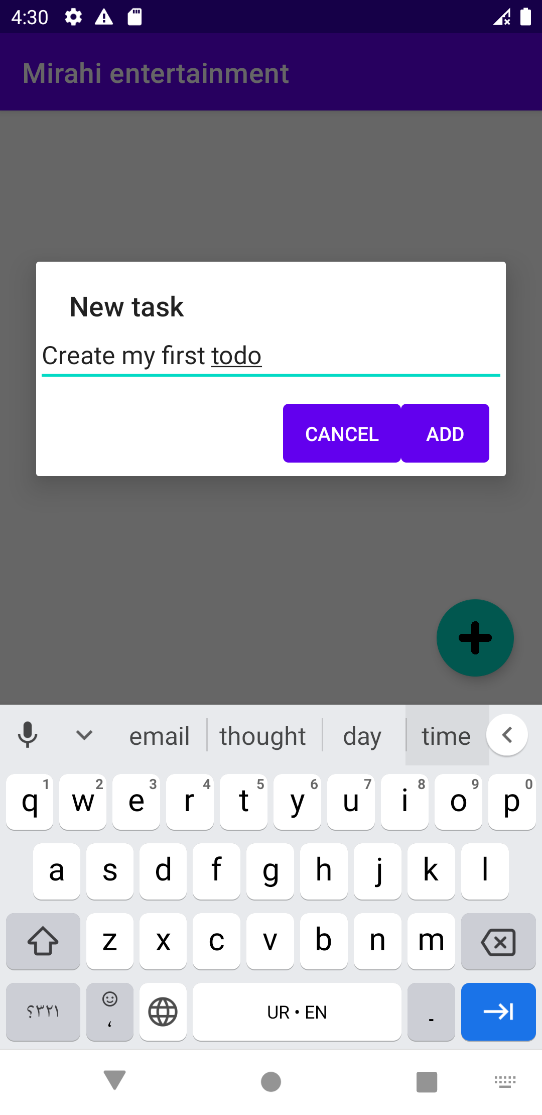
Features
List of tasks
Floating button
When clicked => dialog to add a task
Checkable Tasks
With design changes
Long press to delete
With confirmation dialog

Slide 6

Management
"Pair" programming : Implementing features together
Taking turn on roles with screen sharing
Git and Pull Request

Slide 7
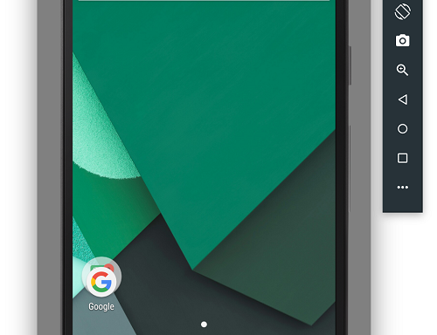



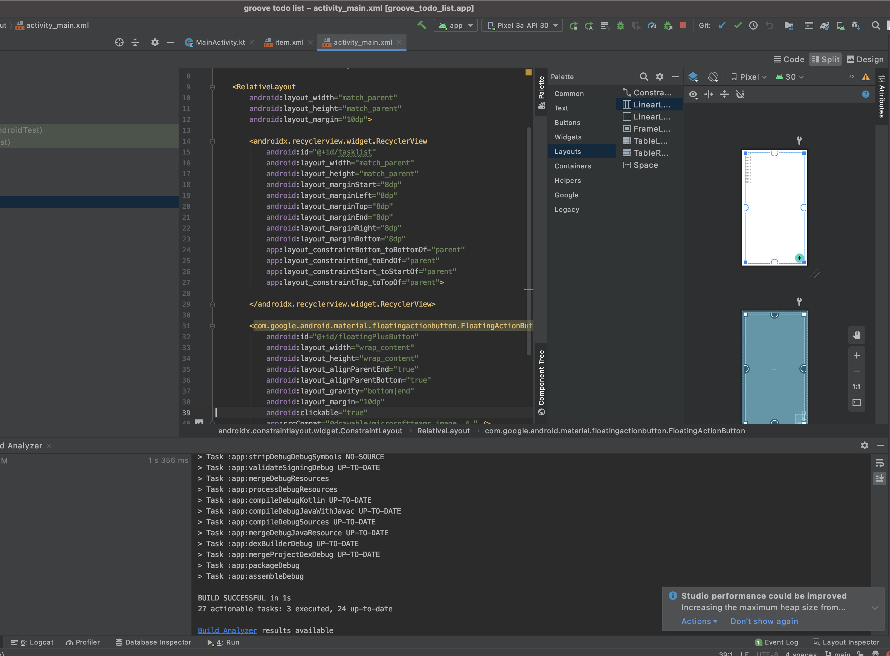
Our tools
Microsoft Teams
Android Studio
Android Emulator
Git and GitHub

Slide 8

Android: The basics
Logic is separated from UI
java folder:
Logic in .kt files (or .java)
res folder
UI in .xml files (with UI)
Assets

Slide 9
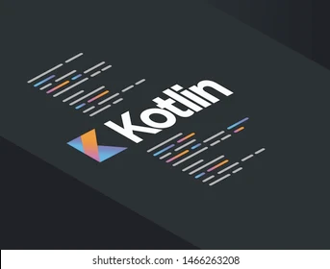
Kotlin: the basics
No static or final keyword
OOP
Var == let
Val == const
Apart from that very similar to JavaScript with a hint of Java

Slide 10
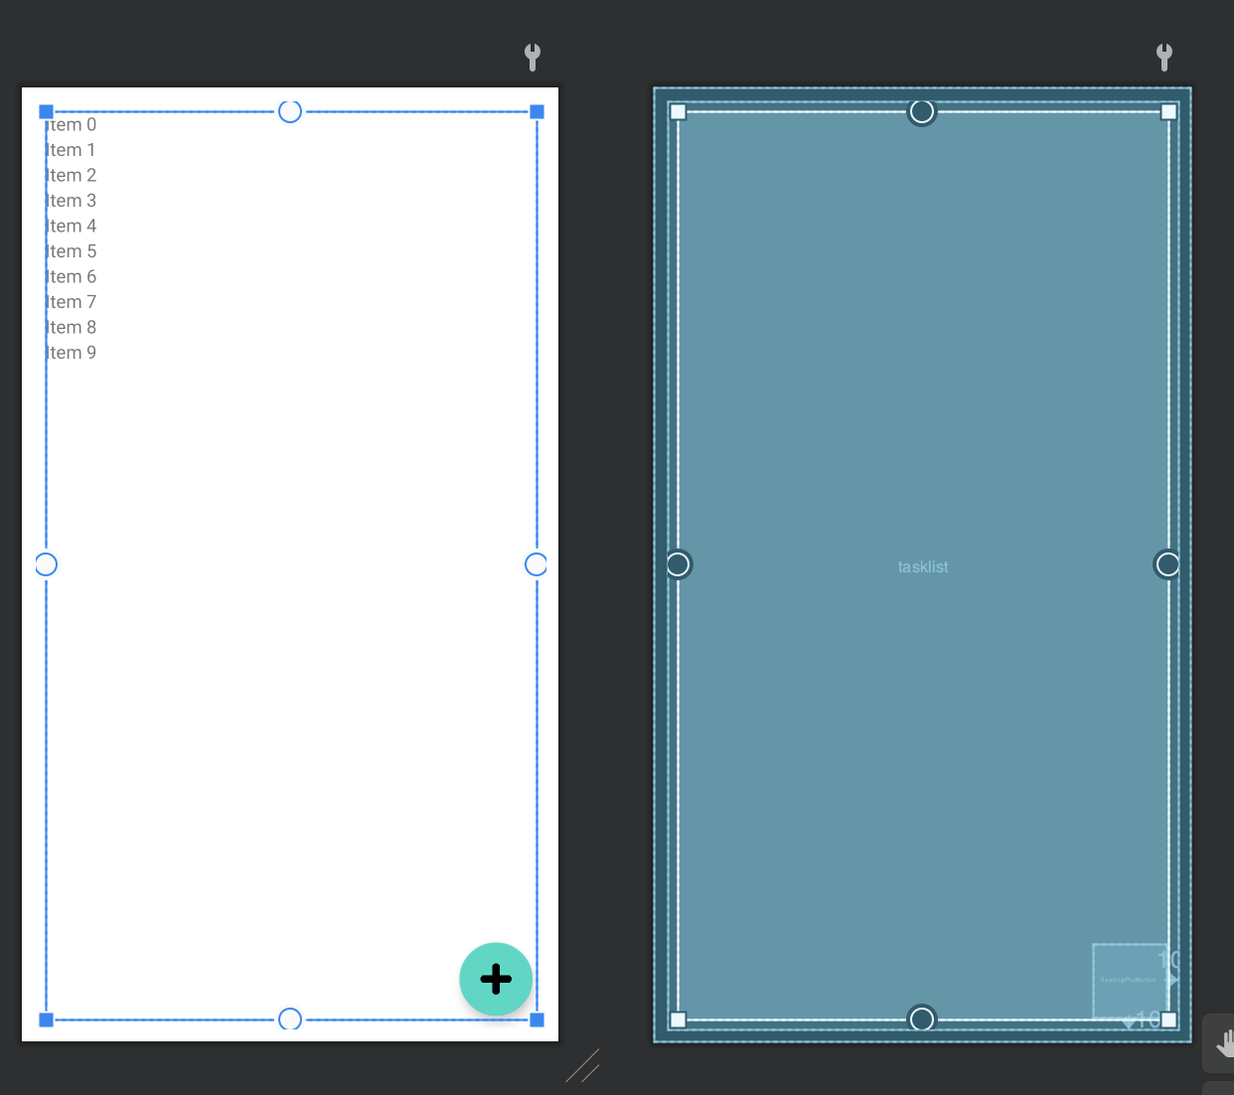
Android layouts
UI for managing making UI
Xml files underneath

Slide 11
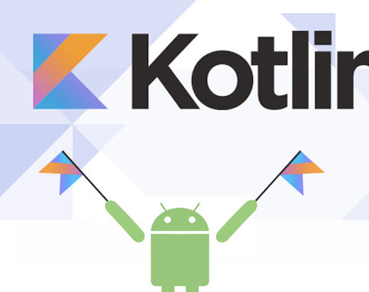
Why would you make a Kotlin app
Easier to get used to than Java
Less error prone than Java (no more NullPointer Error)
Write less code for the same app
You need performance
Code can be reused outside of the Android ecosystem (Backend, Frontend or even iOS) to a certain extend

Slide 12

Why wouldn't you make a Kotlin app
Not yet a standard. Lot of devs still making Java apps
You need one codebase for Android and iOS

Slide 13

Difficulties
Git
Android Studio
Android Layout
Lack of OOP experience

Slide 14
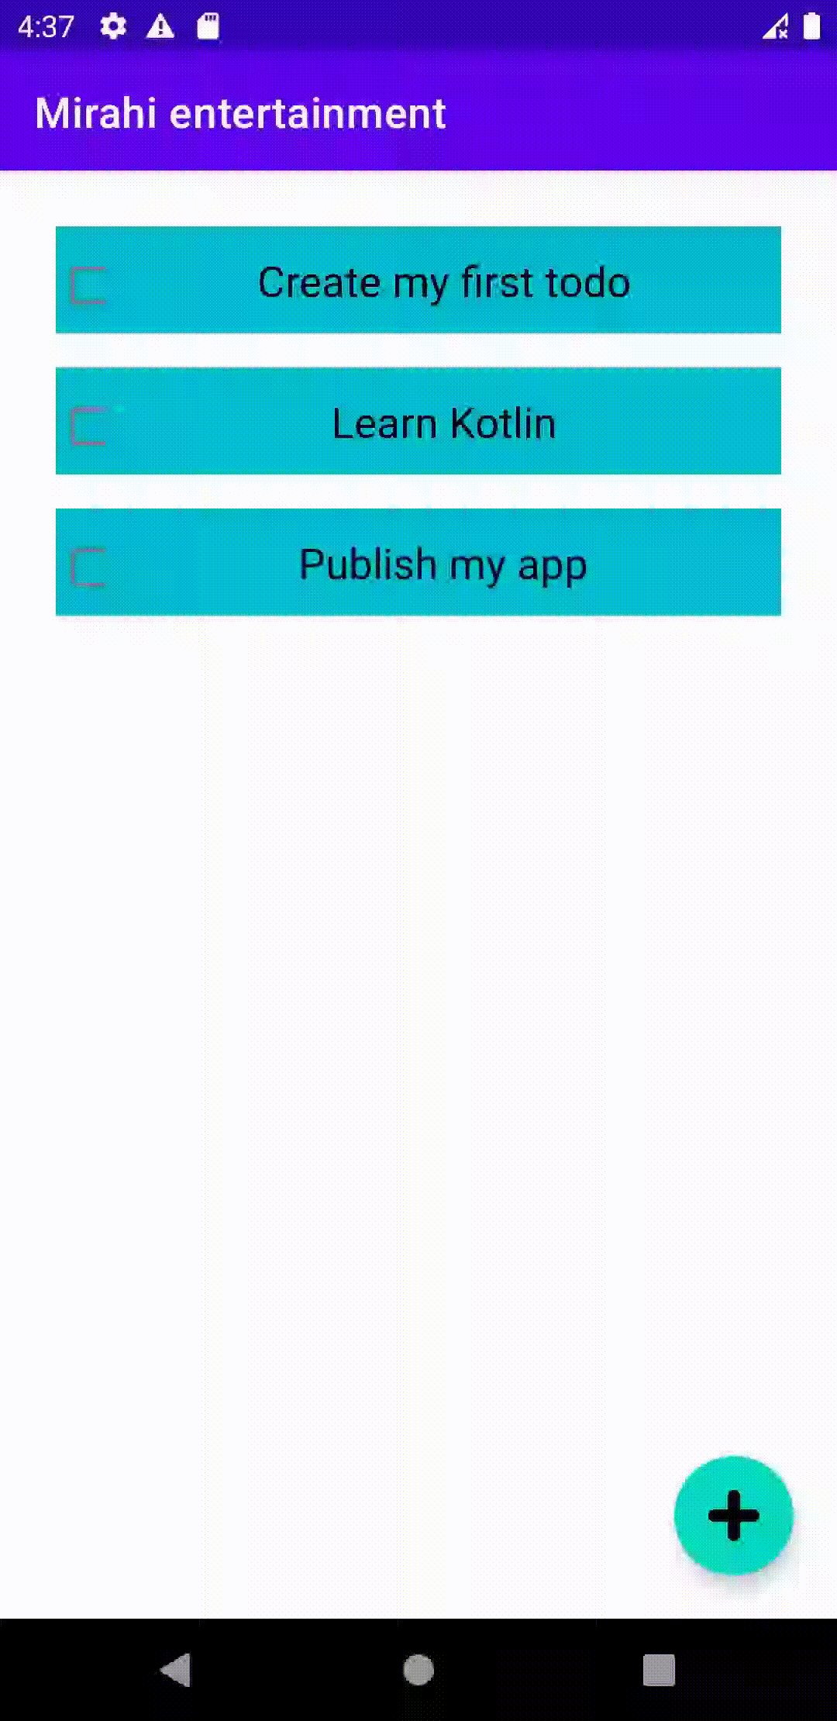
Demo

Slide 15
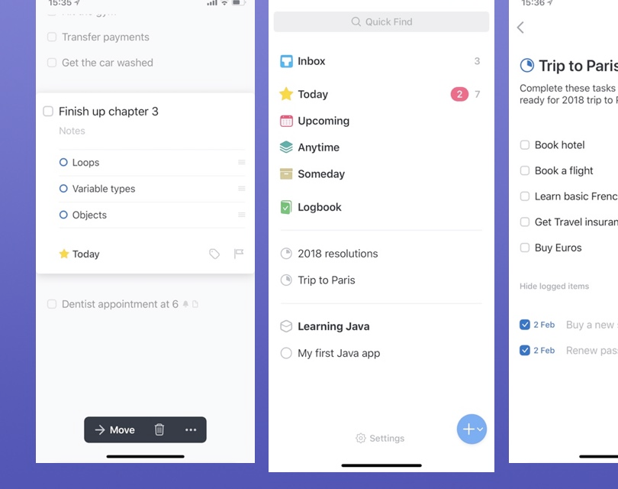
Improvement
Better design
Code refactor
More features
Change task order
Persistance
Calendar Sync (WebDAV)
Tags
Sharing
CI/CD

Slide 16
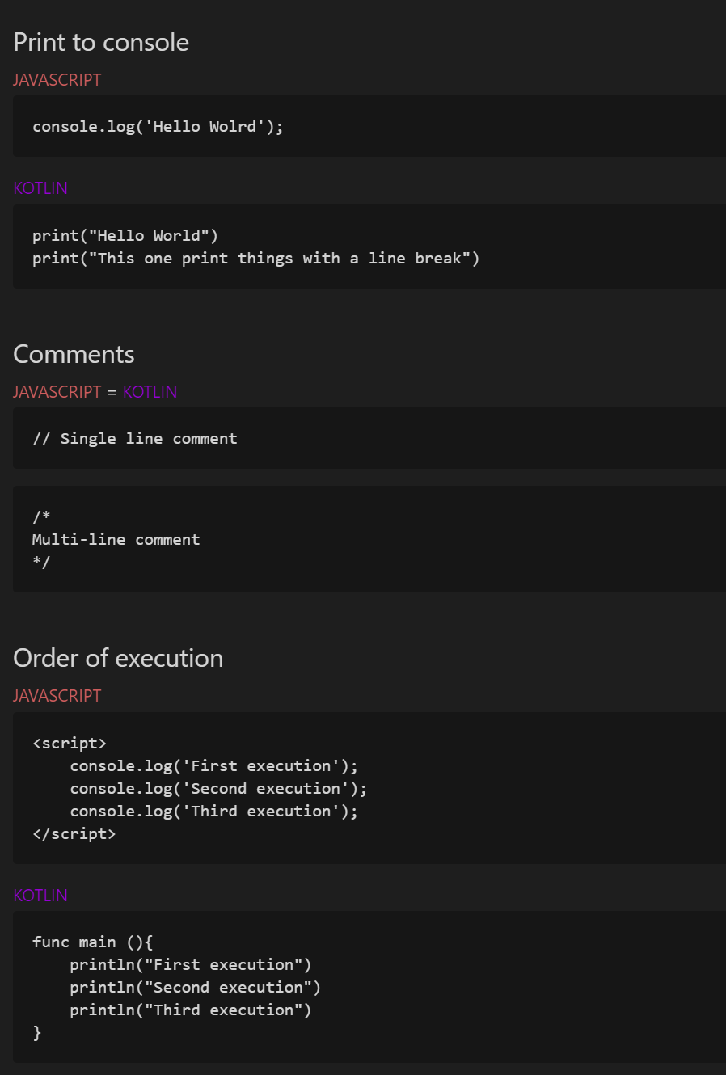
The Cheat Sheet
Made for JS developers
A lot of the syntax is similar
Math is the same
Real mutability on Kotlin but not in JS
Loops are more or less the same
Heavily OOP
A JS dev should be able to read Kotlin with ease, but maybe not write it

Slide 17

Questions ?

